Slide 1
Index Construction

Slide 2
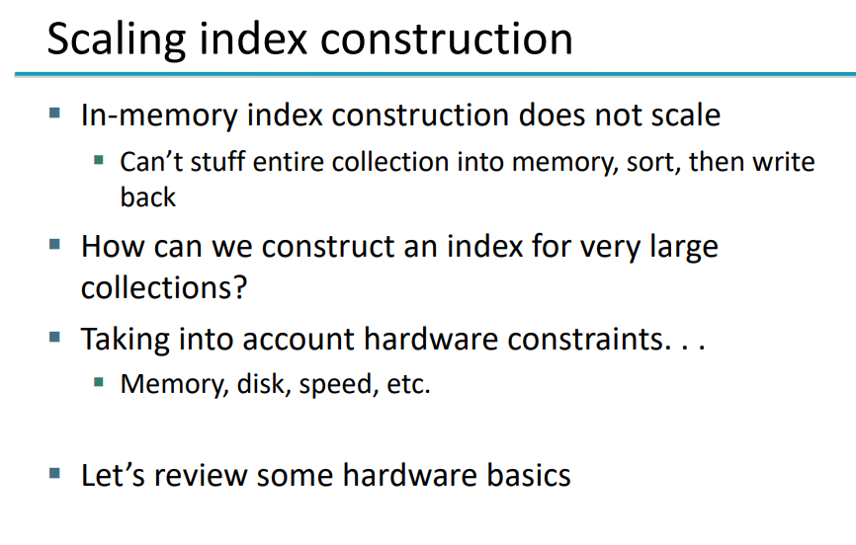

Slide 3
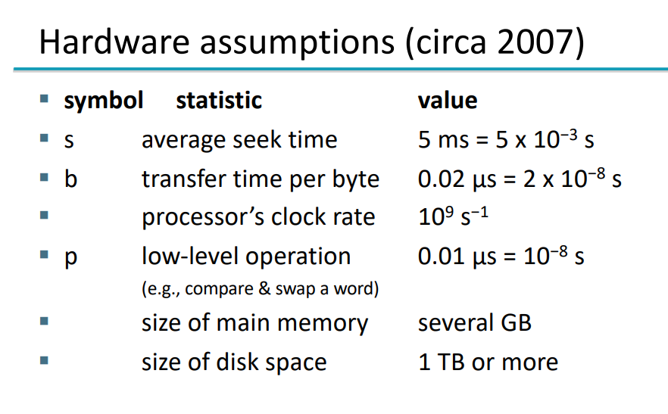

Slide 4
Hardware Basics
When building an information retrieval (IR) system, many decisions are based on the characteristics of the computer hardware on which the system runs.
CACHING
Seek Time
Operating systems generally read and write entire blocks. Thus, reading a single byte from disk can take as much time as reading the entire block.
Servers used in IR systems typically have several gigabytes (GB) of main memory, sometimes tens of GB. Available disk space is several orders of magnitude larger.

Slide 5
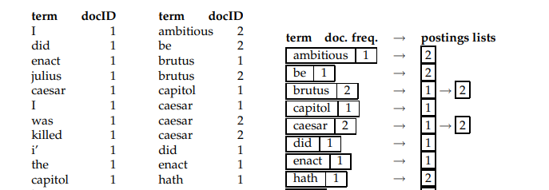
Constructing non positional index :
first make a pass through the collection assembling all term–docID pairs.
sort the pairs with the term as the dominant key and docID as the secondary key
organize the docIDs for each term into a postings list and compute statistics like term and document frequency.
With small data it can be done in memory
With large data set, memory is insufficient , use external sorting algoALGORITHM (minimize the seektime for disk)

Slide 6
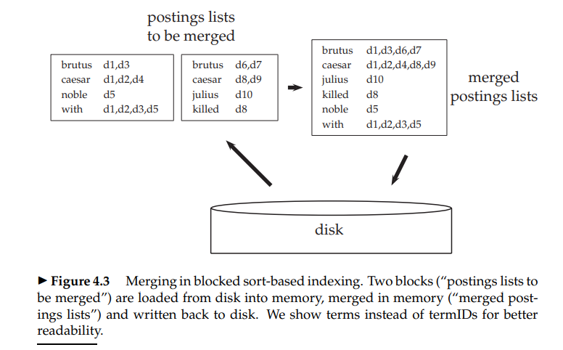
Blocked sort-based indexing
Sequential read is faster than seek.
BSBI:
segments the collection into parts of equal size,
sorts the termID–docID pairs of each part in memory,
stores intermediate sorted results on disk,
merges all intermediate results into the final index.

Slide 7
Single-pass in-memory indexing
For very large collections, this data structure(BSBI) does not fit into memory
Instead of first collecting all termID–docID pairs and then sorting them ( in BSBI), each postings list is dynamic (i.e., its size is adjusted as it grows) and it is immediately available to collect postings.
two advantages:
It is faster because there is no sorting required,
it saves memory because we keep track of the term a postings list belongs to, so the termIDs of postings need not be stored
blocks that individual calls of SPIMI-INVERT can process are much larger and the index construction process as a whole is more efficient.

Slide 8
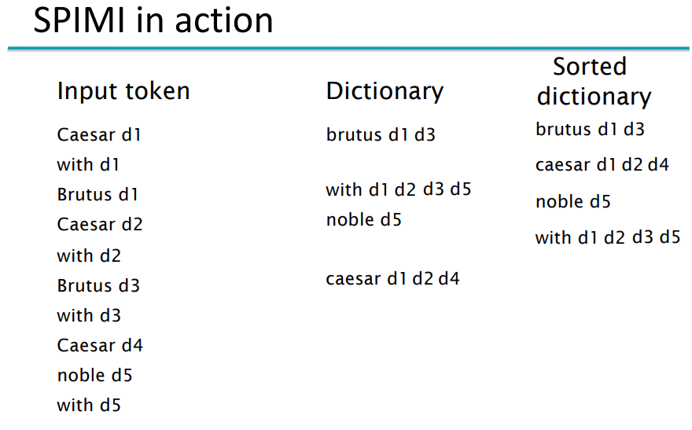
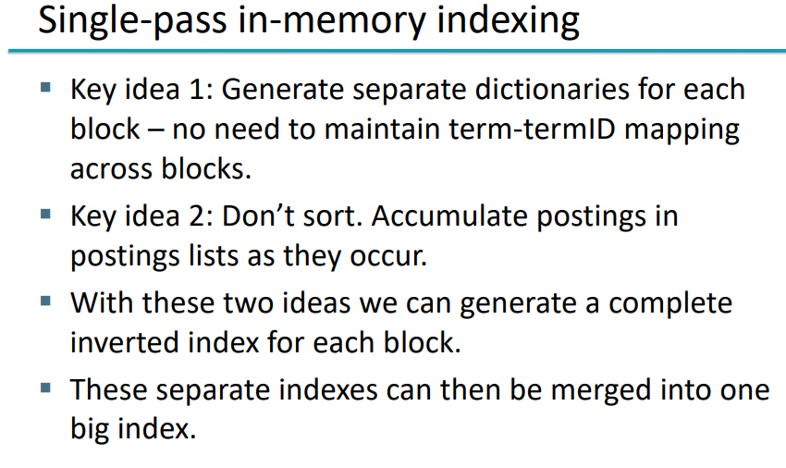
SPIMI

Slide 9
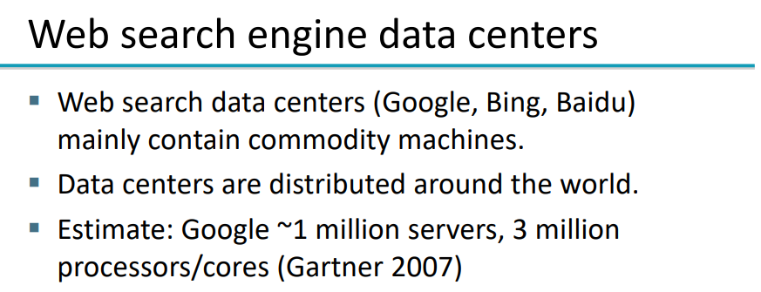
Distributed Indexing
Collections are often so large that we cannot perform index construction efficiently on a single machine.
Individual machines are fault-prone
Can unpredictably slow down or fail

Slide 10
Distributed Indexing
Maintain a master machine directing the indexing job – considered safe.
Break up indexing into sets of (parallel) tasks.
E.g. two sets of parallel tasks
Parsers
Inverters
Break the input document collection into splits
Each split is a subset of documents (corresponding to blocks in BSBI/SPIMI)
Master machine assigns each task to an idle machine from a pool.

Slide 11
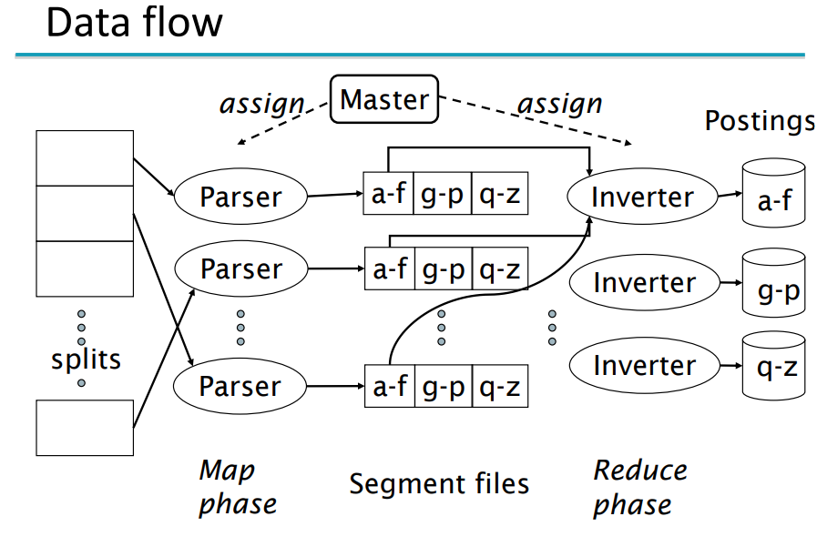

Slide 12
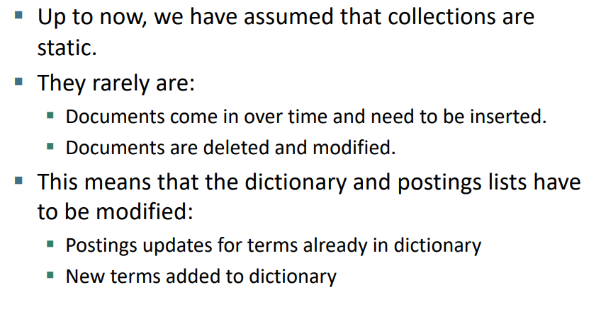
Dynamic Indexing

Slide 13
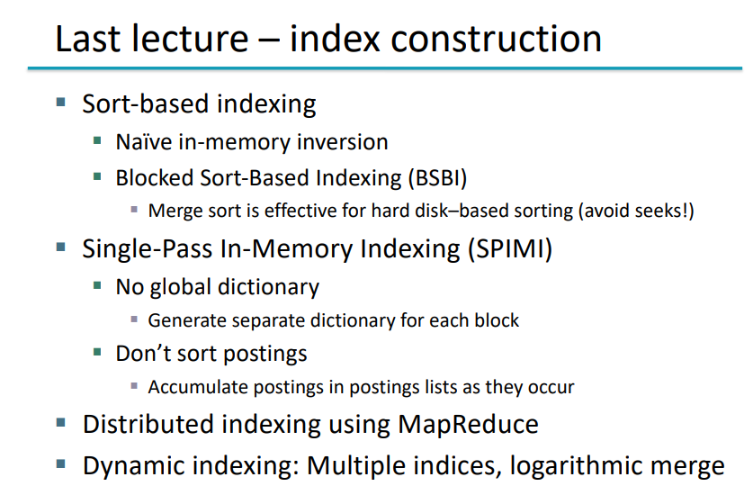

Slide 14
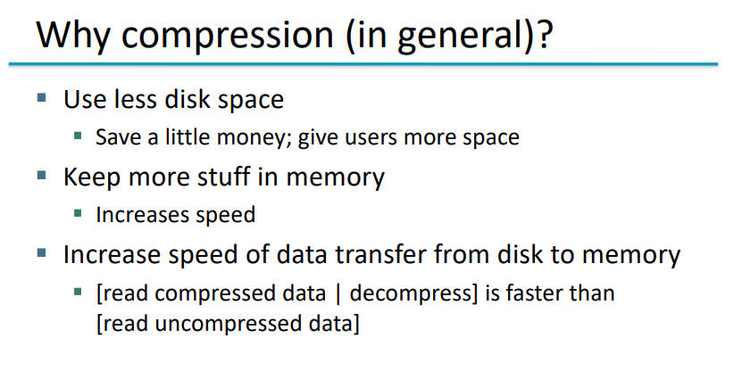

Slide 15
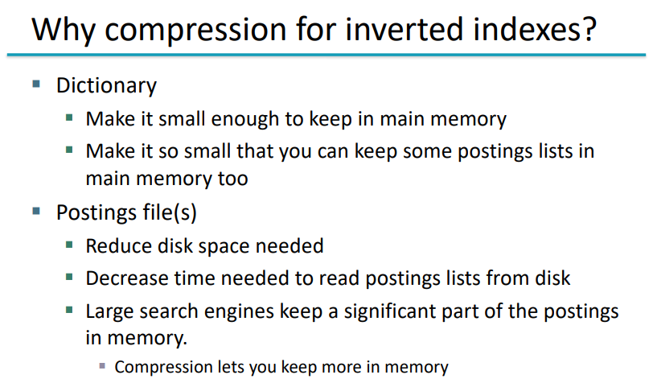

Slide 16
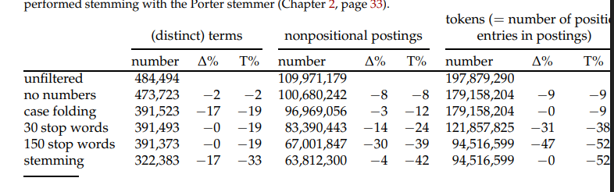
Statistical properties of terms in information retrieval

Slide 17
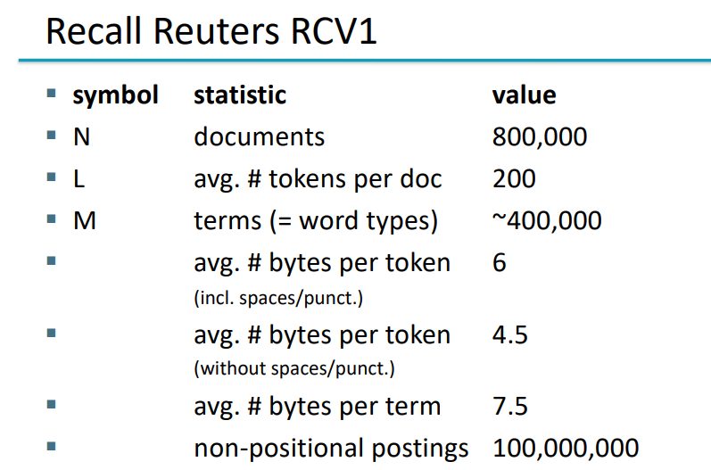
Rule of 30
The rule of 30 states that the 30 most common words account for 30% of the tokens in written text (31% in the table).

Slide 18
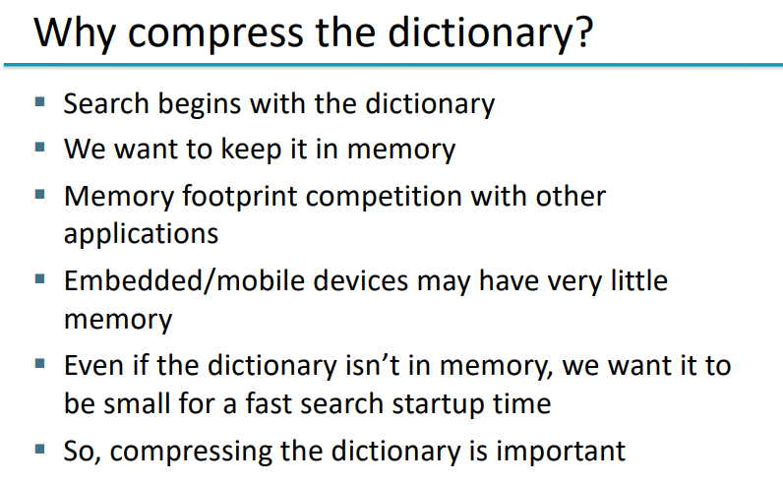

Slide 19
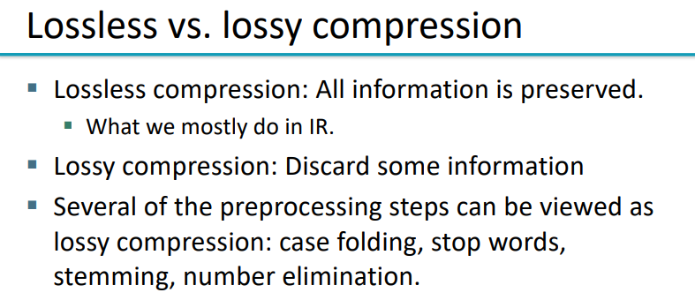

Slide 20
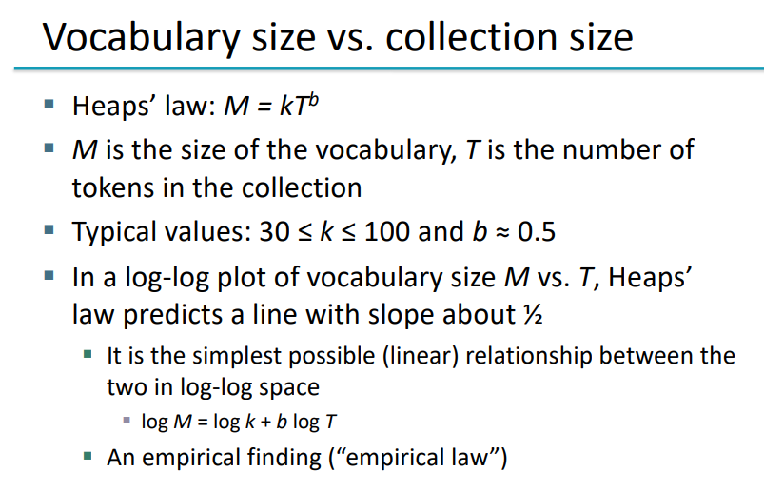
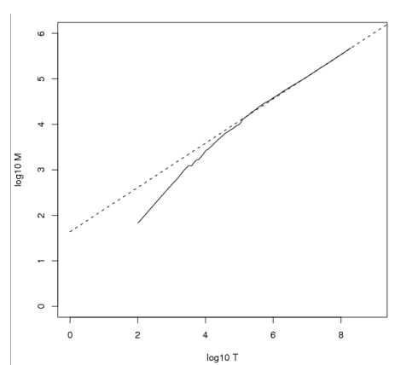
Power Laws

Slide 21
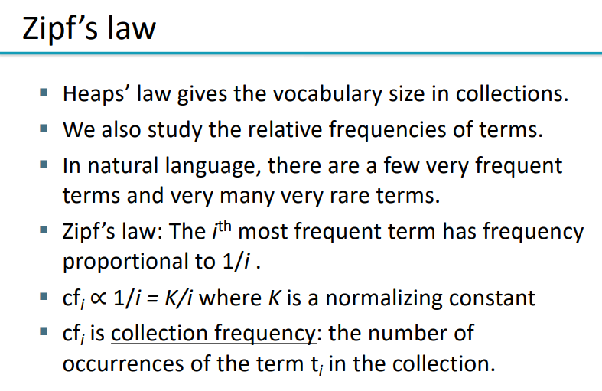
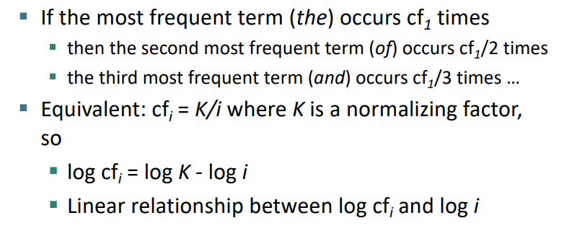

Slide 22
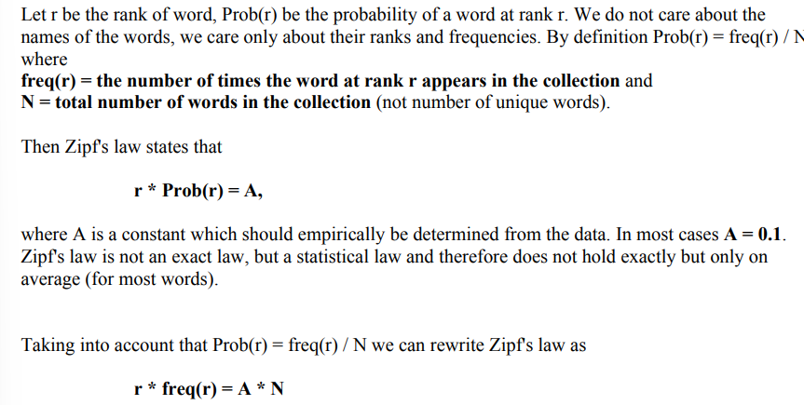
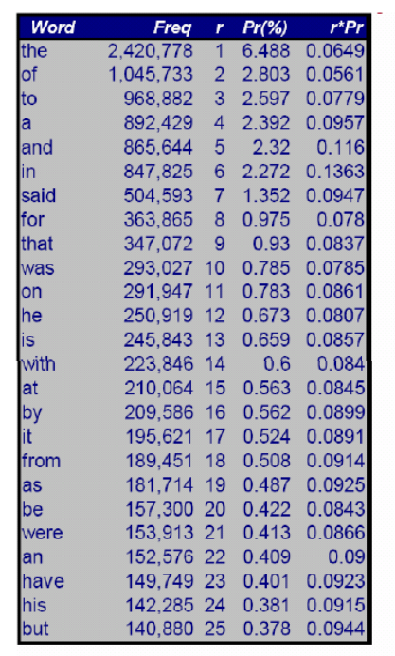

Slide 23
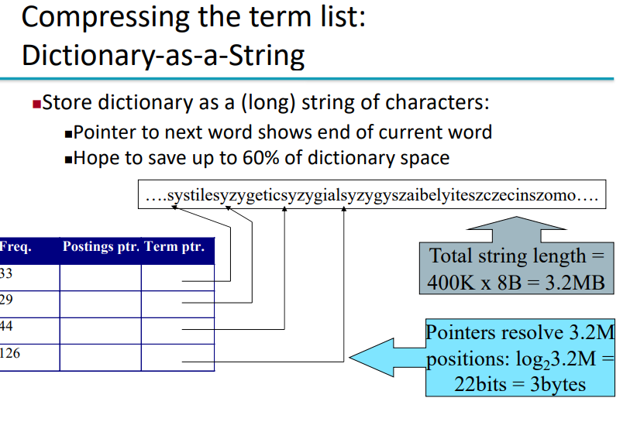
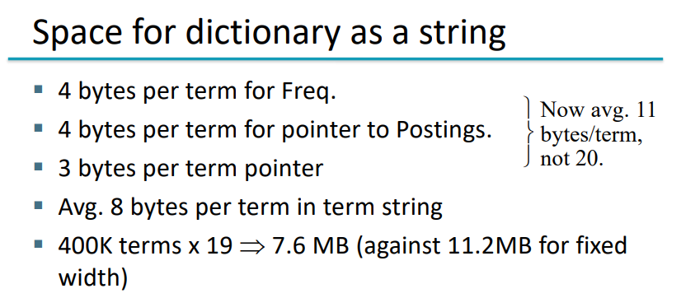

Slide 24
